Slide 1
Promoting DragonRaas
By Sunny Patel, Jasmine Bhoola
Notes:
Talk about what DragonRaas is, just a few sentences. Then talk about

Slide 2
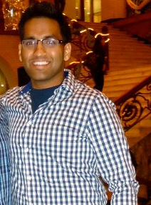

About Us Co-publicity Chairs
Notes:
talk about ourselves and backgrounds related to our experience

Slide 3
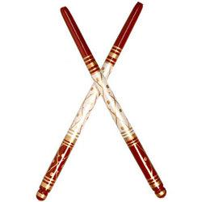
What Is Raas?
Native to Gujarat, India
Originally performed only by men
Use two wooden sticks, called Dandiya
Creative dance moves today make this into a more competitive performance
Notes:
Popular folk dance that originated in Gujarat, India. Originally only performed by men using two wooden sticks called dandiya. Today both men and women will take part occasion. The creativity of dance moves give rise to the upbeat dance that the teams perform to today.

Slide 4
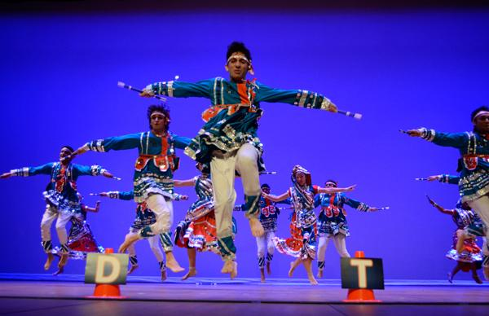
Dragon Raas
Intercollegiate
Held annually
Asian Culture
Give back to the community
Notes:
purpose of the dance competition

Slide 5
Research
RaasChaos at Washington, D.C.
Meeting with Disha Patel
Conference with Fareed
Notes:
Disha was a great resource to speak to about this competition. She is a member of the executive board for Raasadelphia, and has a lot of experience doing promotions.

Slide 6
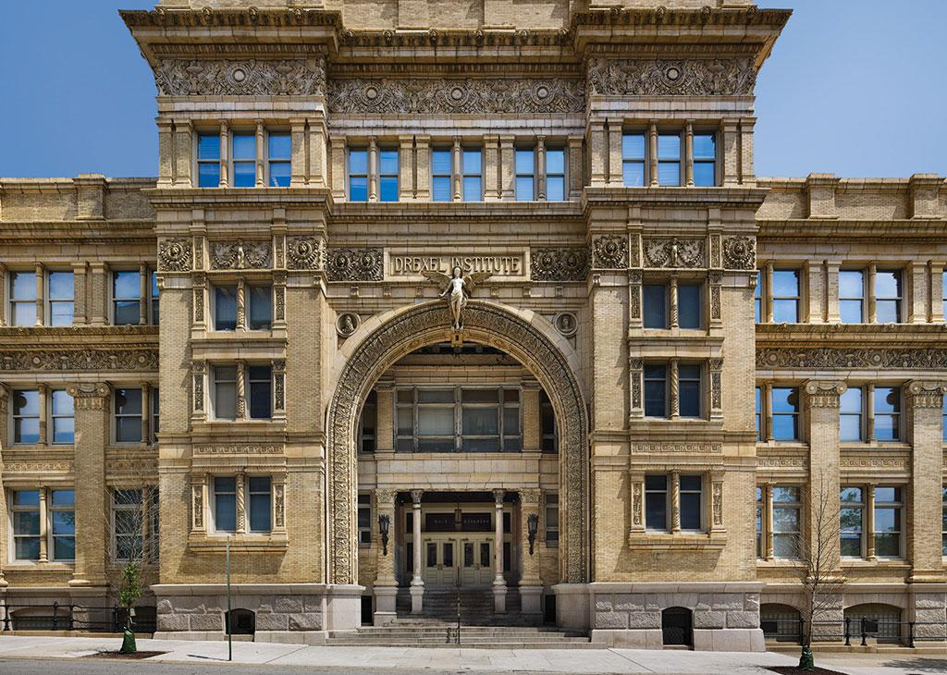
Drexel University Main Auditorium
Research
Directions will be available via Google Maps!
Address: 3141 Chestnut St Philadelphia, Pennyslvania 19104
Saturday January 26, 2013

Slide 7
Tickets
Tickets will be sold at Ticketmaster.com!
$10 for Drexel students and $15 for general admission!

Slide 8
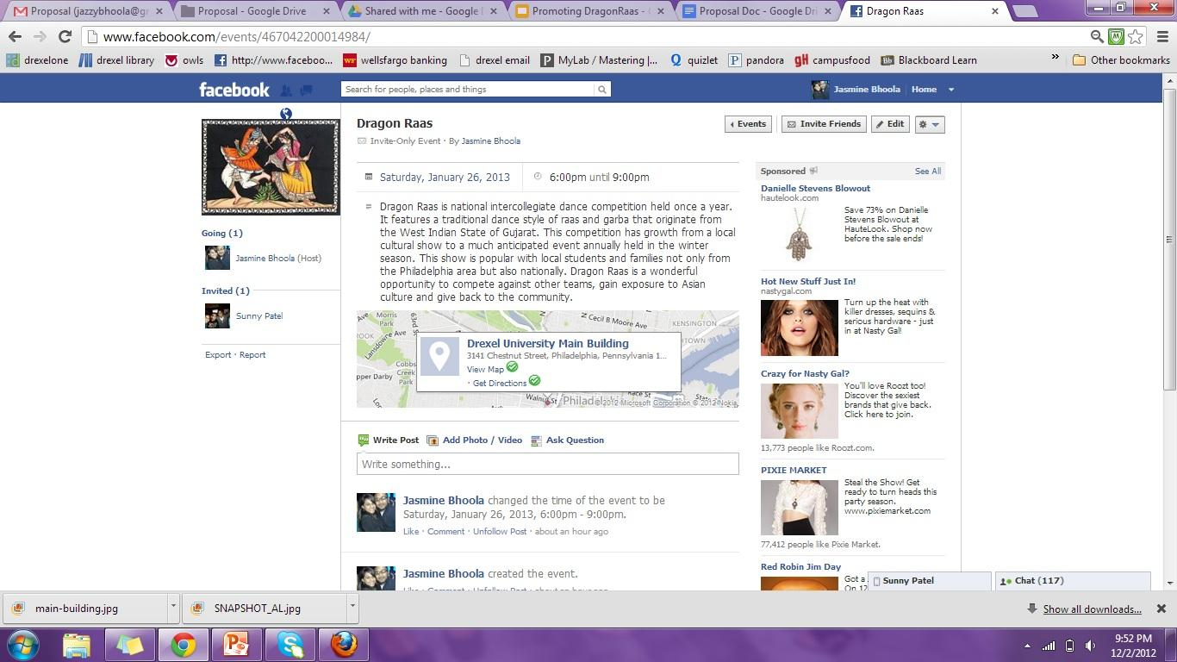
Contact us
Dragonraas@gmail.com or checkout our Facebook page

Slide 9
Promo Video
PROMO VIDEO WOULD BE HERE

Slide 10
Website
dragonraas.wordpress.com

Slide 11
